Slide 1

Business Intelligence – Rawls College of Business
Final Presentation

Slide 2




Business Intelligence – Project Final Presentation
Group 7 – Team members
Ali EZZAOUOUI Aspiring Data Scientist
Benjan ADHIKARI Aspiring Data Scientist
Rushit PARMAR
Data Analyst
Zoumana KEITA Data Scientist/ML Engineer

Slide 3
Agenda
Objective
Data Procurement Strategy
Obstacles and Solutions
Conclusion

Slide 4





Objective
Problem Statement
The goal of the project is to analyze whether the population growth impacts energy consumption, food production, inflation and GDP⁽¹⁾ per capita.
Energy consumption
Food production
Impact?
Inflation
Population growth
GDP Per Capita
Figure 1: Problem statement diagram

Slide 5


Data Procurement Strategy
Our ETL Approach
The following steps provide a high level overview of the ETL process applied to the data procurement.
Extract
Transform
Load
1
2
3
Extraction via internet
Web Scraping
Data cleaning
Data enrichment
Data merged into a single file
🌏

Slide 6
Data Procurement Strategy
Extraction - About the Data
We collected data from multiple websites, in addition to web scraping.
Data | Description | Sources | Strategy
Area | The area of a given country. | World Population Review | CSV dumps
Country | The name of a country. | CountryCode | Csv dumps
Energy | Country’s energy consumption in terawhatt-hours. | GitHub | Csv dumps
Food | Agricultural production for a given country in tones. | Visual Capitalist | Csv dumps
GDP Per Capita | Gross Domestic Product of a given country ($). | The World Bank | Csv dumps
Inflation | The inflation level within a country. | The World Bank | Csv dumps
Population | The population density of a country. | Kaggle | Csv dumps
Country Code | A sequence of letters representing a country. | CountryCode | Web scraping
Table 1: Data Source Description

Slide 7
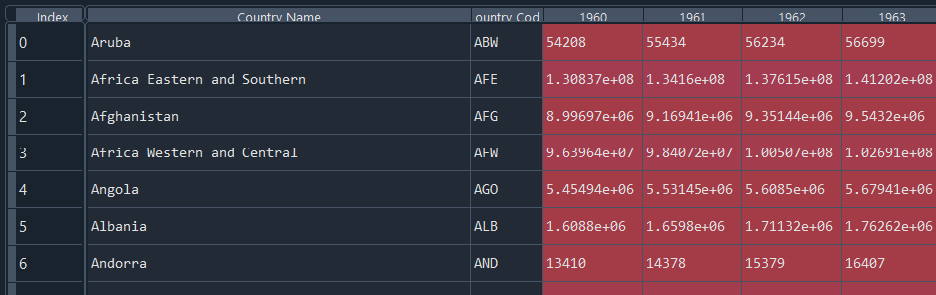
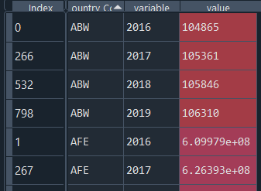
Data Procurement Strategy
Transformation – Data Cleaning & Enrichment
Columns into observations
After collection all the data, the goal was to clean individual data for further combination.
Column selection
Column normalization
1
2
Select relevant columns for the analysis.
Change some columns into observations.
Rename some colums for standardization.
Data types normalization
Data enrichment
3
4
Change data types of the columns for further merge.
Creating new colums for more granularity.
Missing values management.

Slide 8
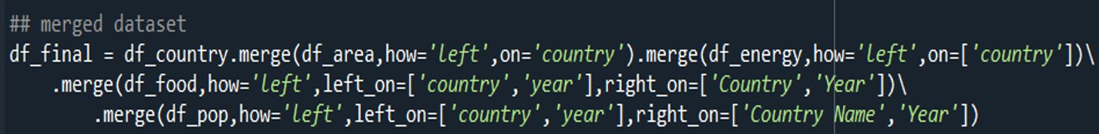


Data Procurement Strategy
Load
Here comes the final step of the data procurement.
Individual data
Final merged data
Merging Process
Figure 4: Data merging diagram

Slide 9
Data Procurement Strategy
Breaking down the Missing Values
Multiples approaches have been used to deal with NULL values. Some of them are illustrated below.
Missing % with respect to “Year”.
Missing % with respect to “Area”.
6%
Dropped because they have more than 50% missing attributes.
1%
1
Missing % with respect to “Rank”.
1%
100%
Median replacement
2
92%
Mainly replaced the rest of the missing data with median because of the data distribution.
Overall data
Figure 2: Percentage of missing values in Area, Year and Rank columns

Slide 10
Data Procurement Strategy
Transformation – Focus on Missing Values
The distribution analysis helped in better understanding the replacement approach to be applied.
Attributes with missing values
% missing values
Data distribution
Replacement
Food production in tonnes per capita
18
Food production in tonnes
17
Inflation
11.5
GDP per capita
10.73
Mainly skewed
Median
Population
9
Population Density
9
Energy consumption terrawatts hours per capita
9
8
Primary energy consumption terrawatts per hour
9
Figure 3: Percentage of missing values in the rest of the columns and their replacement approach

Slide 11
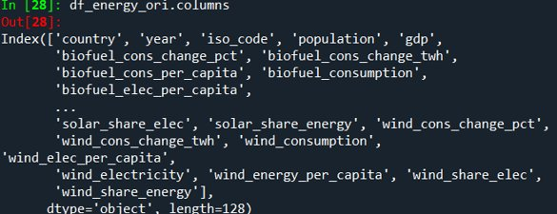
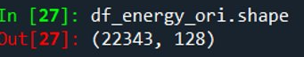
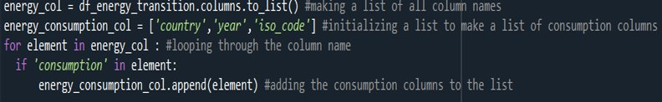
Obstacles & solutions
4 Main Obstacles & Corresponding Solutions
Here comes the final step of the data procurement.
Obstacles
Solutions
Data gaps (missing country names & codes).
Fill missing information from web scraped data.
Only about 3% of relevant columns in the energy dataset.
Only select columns containing « consumption » keyword.

Slide 12
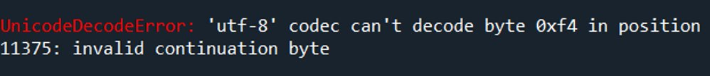
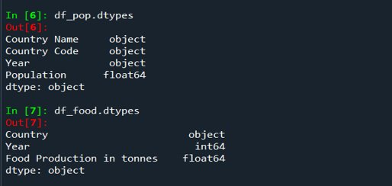
Obstacles & solutions
4 Main Obstacles & Corresponding Solutions
Here comes the final step of the data procurement.
Obstacles
Solutions
File encoding issues
Latin-1 encoding and specification of the separator type when reading the inflation data.
Data types missmatch
Changed the data types using the astype function.

Slide 13
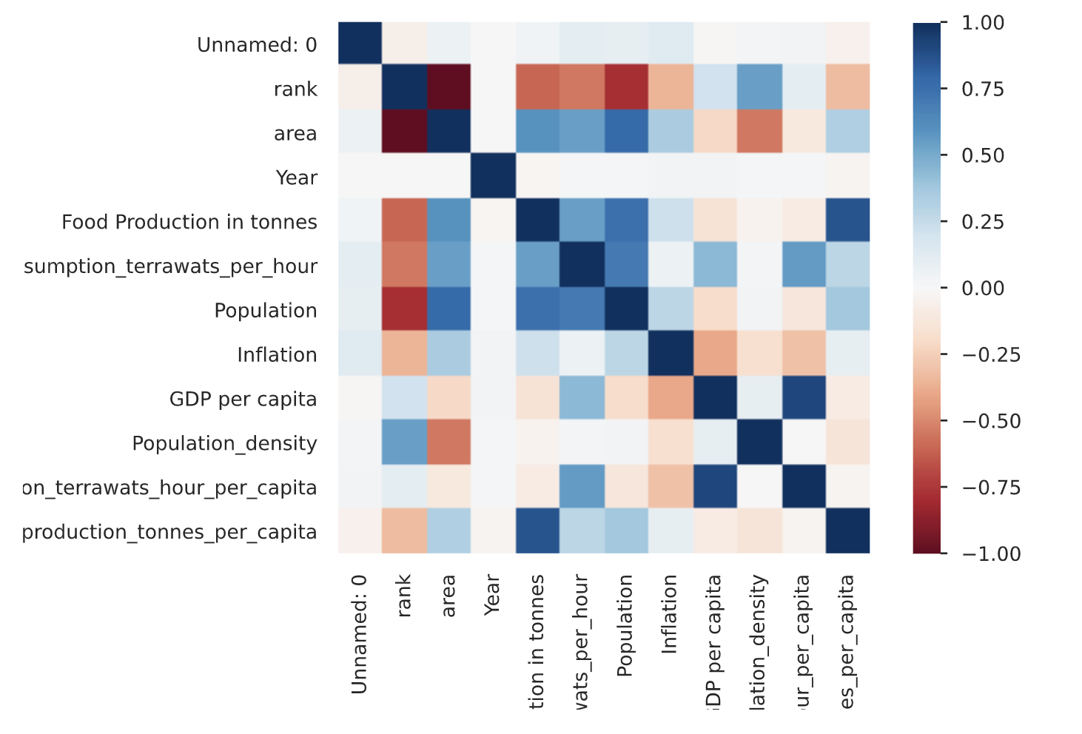


Our findings
💥
❓
✨ Our result
❓ New findings
🤔 Missleading factors
con
➡️
✨
✨
✨
❓
Energy consumption terrawatts hours per capita
❓
🤔
Energy consumption terrawatts hours per capita
con

Slide 14
Conclusion & Next Step
Conclusion
Successful application of the ETL approach to real-life problem.
Understanding of the ETL challenges and how to handdle them.
Most of the time spent in data Transformation.
Capability to transfer the acquired skillsets to similar problems in industry.
Next Step
Perform additional preprocessing and data exploration.
Implement an OLAP⁽²⁾ database along with AWS Cube⁽³⁾.

Slide 15

Thank You For Your Attention
Questions?

